Slide 1

TAM Program
Training Guide | November 2025

Slide 2

Agenda
Strategy and Objectives
Program Overview
Sales Process
Pricing & Financial Information
Frequently Asked Questions
Notes:
.

Slide 3
Strategy
and Objectives
Drives Growth
Increases profitability through controlled, risk-adjusted expansion without compromising credit standards.
Behind this initiative
We aim to align with MHCCA’s MTMP by leveraging partnerships and external capital markets, expanding our financing capabilities, strengthening partner relationships, and positioning MHCCA for sustainable growth.
Enhances Partner Value
Provides alternative financing solutions for declined transactions, strengthening relationships with dealers and strategic partners.
Bring value to our partners
Differentiates MHCCA in the Market
Positions us as a flexible, solutions-oriented partner, competing on innovation and service, not just rates.
Supports MTMP Transformation
Aligns with MHCCA’s strategic roadmap by leveraging external capital markets to broaden our financing capabilities and strengthen our position as a flexible, solutions-driven partner.

Slide 4
Program Overview

Slide 5
General Program
Overview
Purpose
Provide financing for MHCCA transactions declined due to internal credit box through a partnership with Travelers Asset Management (TAM).
Model
Originate-to-Sell:
MHCCA originates the deal and retains the customer relationship and documentation control.
TAM reviews and approves transactions MHCCA cannot fund internally.
TAM purchases approved deals on a bi-monthly basis.
Financing Type
Credit Approach
Pricing
Equipment financing with flexible terms, targeting near-prime and subprime segments.
Broader credit appetite than MHCCA, enabling penetration into segments outside our standard credit box.
Rates follow TAM’s approved grid and are non-negotiable.
Updated monthly; approved rates remain valid for 30 days.
MHCCA credit team approves transactions based on TAM’s grid after partner approval.

Slide 6
Roles and Responsabilities
Sales Team | Submit applications through MHCCA’s standard process. Identify declined deals eligible for TAM Program. Communicate approved terms to customers and partners (vendors/brokers). Ensure correct program designation (TAM–OTS) before documentation and funding.
Capital Markets | Validate eligibility and submit transactions to TAM via the portal. Act as liaison between TAM and MHCCA (documentation requests, approvals). Provide TAM approval form and Age Term Matrix to Sales. Ensure transactions are sold within agreed timelines (max 30 days on MHCCA books).
Credit Team | Process initial applications and issue decline notifications. Approve transactions under TAM Program after partner approval. Update structure and add required comments for compliance.
Operations | Validate program designation and funding package completeness. Follow standard validation procedures for all elements.
Travelers Asset Management | Approve eligible deals and purchase funded transactions bi-monthly. Conduct audits and ensure compliance with program guidelines.

Slide 7
General Process
Overview
1. Declined Deal
2. Eligibility Assessment
3. Transaction Submission
4. Partner Evaluation
Sales evaluates eligibility of the transaction & sends a submission request for TAM Program to Capital Markets.
Capital Markets assesses whether the transaction meets the credit requirements and, if so, submits it through the TAM Portal.
TAM evaluates applications using its credit scorecards and underwriting criteria & Capital Markets sends back decision to Sales.
MHCCA Credit declines a credit request.
5. Deal Documentation
6. Funding by MHCCA
7. Bi-Monthly Sale to TAM
8. Audit and Settlement
Sales sell the approved terms to the client and document the transaction according to standard guidelines.
Funding Partners audits the transactions and funds MHCCA as per the Originate-to-Sell agreement.
MHCCA funds the transaction following standard internal procedures.
MHCCA compiles and sends funded deals to Funding Partners for purchase.

Slide 8
Sales Process
Step 1: Submit Application
Start with MHCCA’s standard credit process.
If declined, proceed to TAM eligibility review.
Step 2: Check Eligibility
Confirm that the transaction meets the TAM Program criterias (refer to the eligibility guidelines).
This is a quick preliminary review, use the decision tree provided in the procedure to verify all conditions.
Step 3: Request Submission in TAM Portal
Email Capital Markets using the TAM–OTS request template.
Include declined credit decision and deal details.
Step 4: Obtain Partner Approval
Capital Markets submits to TAM.
Once approved, you will receive TAM approval form from Capital Markets.
Step 5: Forward to Credit
Send TAM approval and required term (with Age Term Matrix) to MHCCA Credit for final approval.
Ensure structure reflects TAM–OTS program designation.
Step 6: Validate Pricing & Fees
Rates follow TAM grid (non-negotiable, valid 30 days). If applicable, request rate reduction through Pricing team (for non-HD transport transaction only).
Recommend documentation fee:
  Cash: $500
  Financed: $750
Step 7: Inform the Partner
Communicate to the vendor or broker that the transaction has been approved.
Explain that this program offers greater flexibility.
Highlight that pricing is higher than usual due to the broader credit appetite and risk profile.
Reinforce the value: this solution enables funding for deals that would otherwise be declined.
Step 8: Complete Documentation & Funding
Confirm program designation before producing documents.
Follow standard funding requirements and timelines.

Slide 9
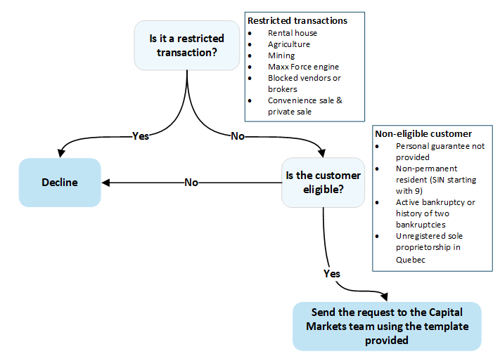
Restricted Transactions
Eligibility Check

Slide 10
Credit Requirements
Eligibility Check

Slide 11
Pricing & Financial Information
 | CR1 | CR2 | CR3 | CR4 | CR5
25,000$-39,999$ | 10,55% | 13,80% | 17,25% | 20,70% | 22,70%
40,000$-99,999$ | 8,55% | 11,40% | 16,55% | 19,70% | 21,40%
100,000$-350,000$ | 8,35% | 11,20% | 15,95% | 19,40% | 21,10%
Permitted rate reductions for non-HD transport transaction only:
CR3, CR4, CR5 → 1%
CR2 → 0.60%
Commission: Your commission is included in the rate grid calculation, same as a standard deal.
Dealer Commission: Dealers may add a commission.
Volume Reporting: Volume will be counted toward your figures.
Projected Annual Volume: $30MM

Slide 12
Next
Steps
Deal Submission: Starting Wednesday, you may begin submitting deals.
Review the Procedure: Please read the attached process document.
Join Weekly Calls: Participate in the scheduled calls to provide feedback.
Continuous Improvement: The process is still evolving; your input is essential for optimization.

Slide 13
Frequently Asked Questions
What is the TAM Originate-to-Sell Program?
A partnership allowing MHCCA to originate deals that Funding Partners purchases after approval, enabling funding for transactions outside MHCCA’s credit appetite.
Why was this program created?
To provide alternative financing solutions for declined transactions and support MHCCA’s strategic growth objectives.
Which transactions qualify for the program?
Deals declined under MHCCA’s internal credit criteria but meeting TAM’s eligibility guidelines.
Are there any restricted sectors or conditions?
Yes—certain industries (e.g., rental houses, agriculture, underground mining) and credit situations (e.g., active bankruptcy) are excluded.
Is pricing negotiable?
No. Rates follow TAM’s grid, updated monthly, and remain valid for 30 days. The only exception is for rate reduction for non-HD transport transaction only.
Can documentation fees be financed?
Yes, but upfront payment is preferred and incentivized with a discount.
Who communicates with the customer?
MHCCA retains the customer relationship and handles documentation.
What is the role of Capital Markets?
They submit eligible deals in the TAM Portal and manage partner communication.
What happens if a deal doesn’t meet TAM’s criteria?
It remains declined and cannot be funded under this program.

Slide 14
02
Appendix

Slide 15
Standard Email Format for TAM Requests
Subject: TAM Portal Submission Request – [Application Number]
Hi,
Can you please submit the following transaction in the TAM portal?
Application Number:
Credit Decision (Decline): Attached
Client Name:
Amount:
Asset Description & Price Check:
Other Information:
Thank you for your assistance.
Best regards,

Slide 16
Blocked Vendor List
Pride Truck Sales
Diesel Truck & Trailer
Guru Nanak (GN) Truck Sales
BVD Truck Sales
Big Rig Trailers & Leasing
Diamond Truck Sales
TRUCKandCAR.CA (DBA for 2127376 Ontario Inc)
Cold Iron Truck Center
Trailer Zone Sales and Leasing Inc (affiliated with Cold Iron)
NEXGENCO Truck & Trailer Sales & Financing
1000927605 Ontario Inc (Affiliated with Pride)
Orangevill Auto Haus Inc
Multi Truck Sales – New Pride Group (owned by one of the sons)
Truck Point
Able Truck Sales
BG Truck
9131-2561 Québec Inc
Auto Nand
Ultimate Centre Du Camion
Truck World
Trusted Truck Sales
Fastway Truck Sales
Zenith Truck Sales
Nisku Truck Sales
Target Equipment
GTA Forklift Sales Inc
Snowville Truck Sales
JMD Ventures Ltd

Slide 17
Blocked Broker List
Lantern Capital
Blue Bloods
Blue Capital Equipment Finance
Easy Lend
Paramount Leasing Ltd
Frazer Valley Truck Trailer Financing Ltd
Axion Finance
Manning Finance
Magma Leasing
TopLink
Planet Financial
Big Rig Financing & Leasing Inc
Fraser Valley Truck Trailer Financing Ltd
2592140 Ontario Inc (DBA Axion Finance)
Best Choice Truck and Trailer Sales (2522137 Ontario Inc)
Top Choice Auto
Uplend (QC Deals)
FINCO Financial Group Inc
First Choice Financial Limited
Easy Lend
CDL Capital Limited
Classic Capital Inc
Raptor Financial Group Ltd
Best Link Financial
Big Rig Financing & Leasing Inc
Pacific Northwest Mortgage Corporation
Blue Fund

Slide 18
Have Questions? Contact Us
Francis Nantel-Robidoux
Director, Syndications & Capital Markets
Email: fnantel-robidoux@mhccna.com
Mobile: +1 438-861-2281
Lauralie Lemire Nantais
Business Partner, Strategic Initiatives
Email: llemire@mhccna.com
Mobile: +1 514-269-5262

